Slide 1



Exploring High-Energy Atmospheric Muons with IceCube: Investigating Prompt Muon Normalization and Unfolding the Muon Flux Pascal Gutjahr
March 18, 2025
Source: NASA

Slide 2
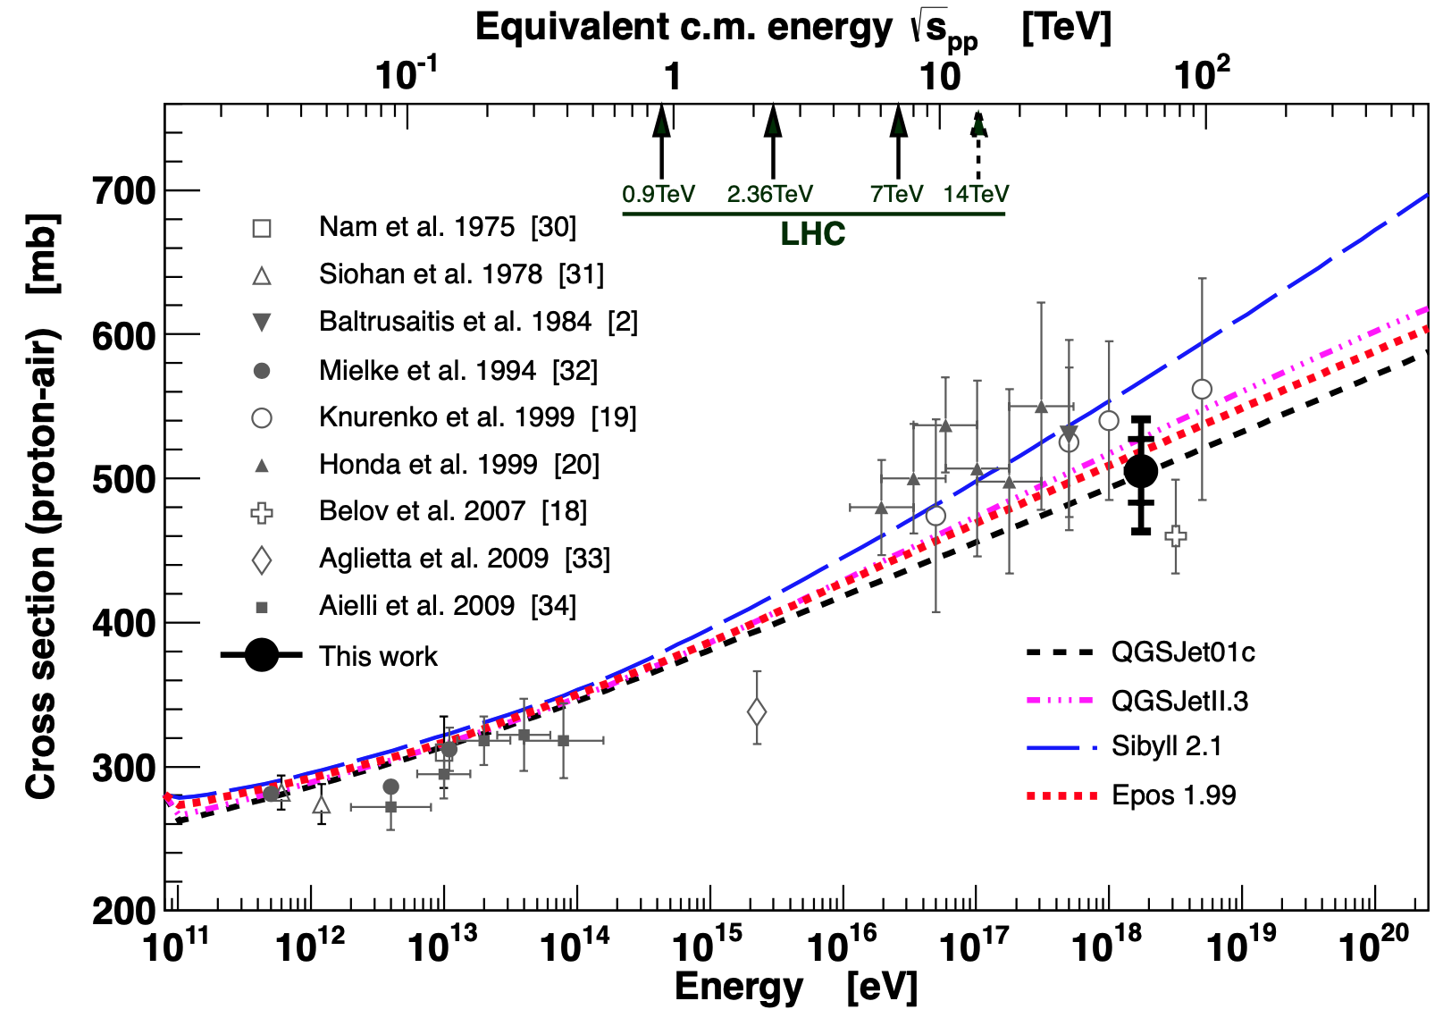
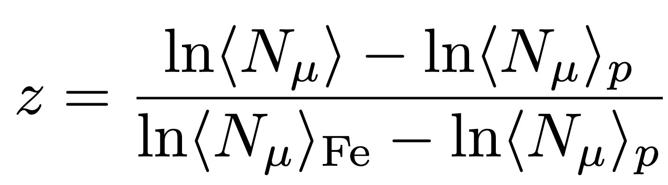
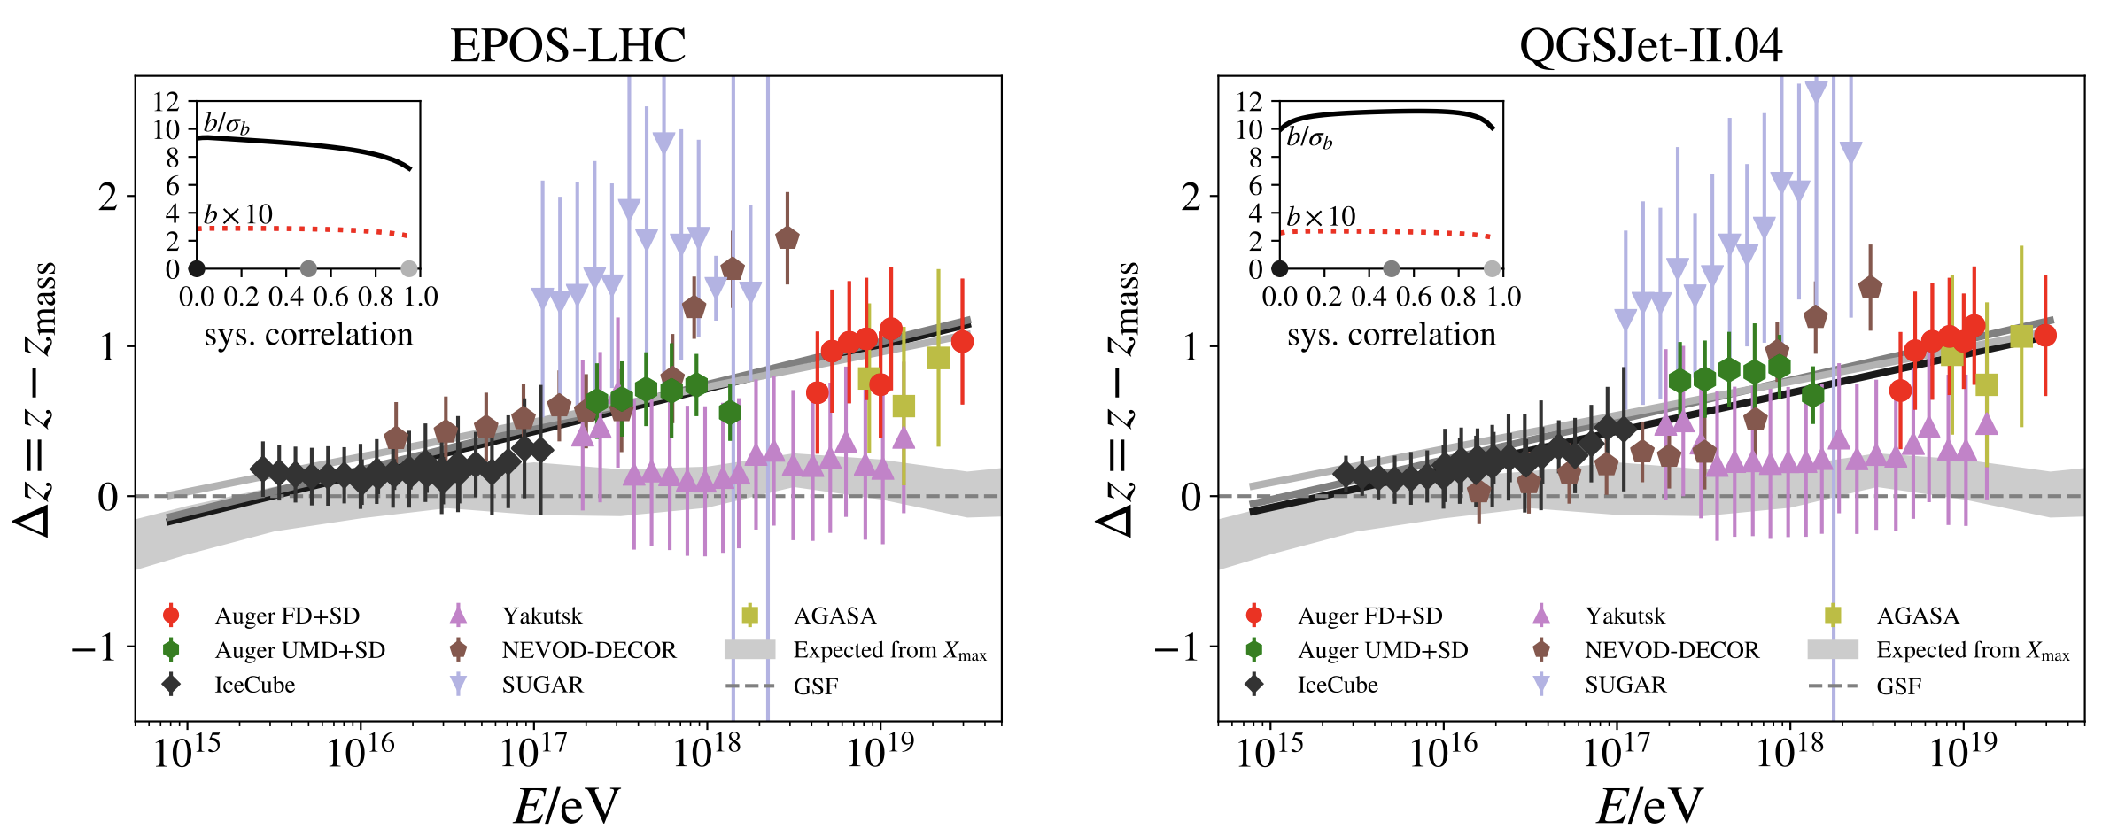
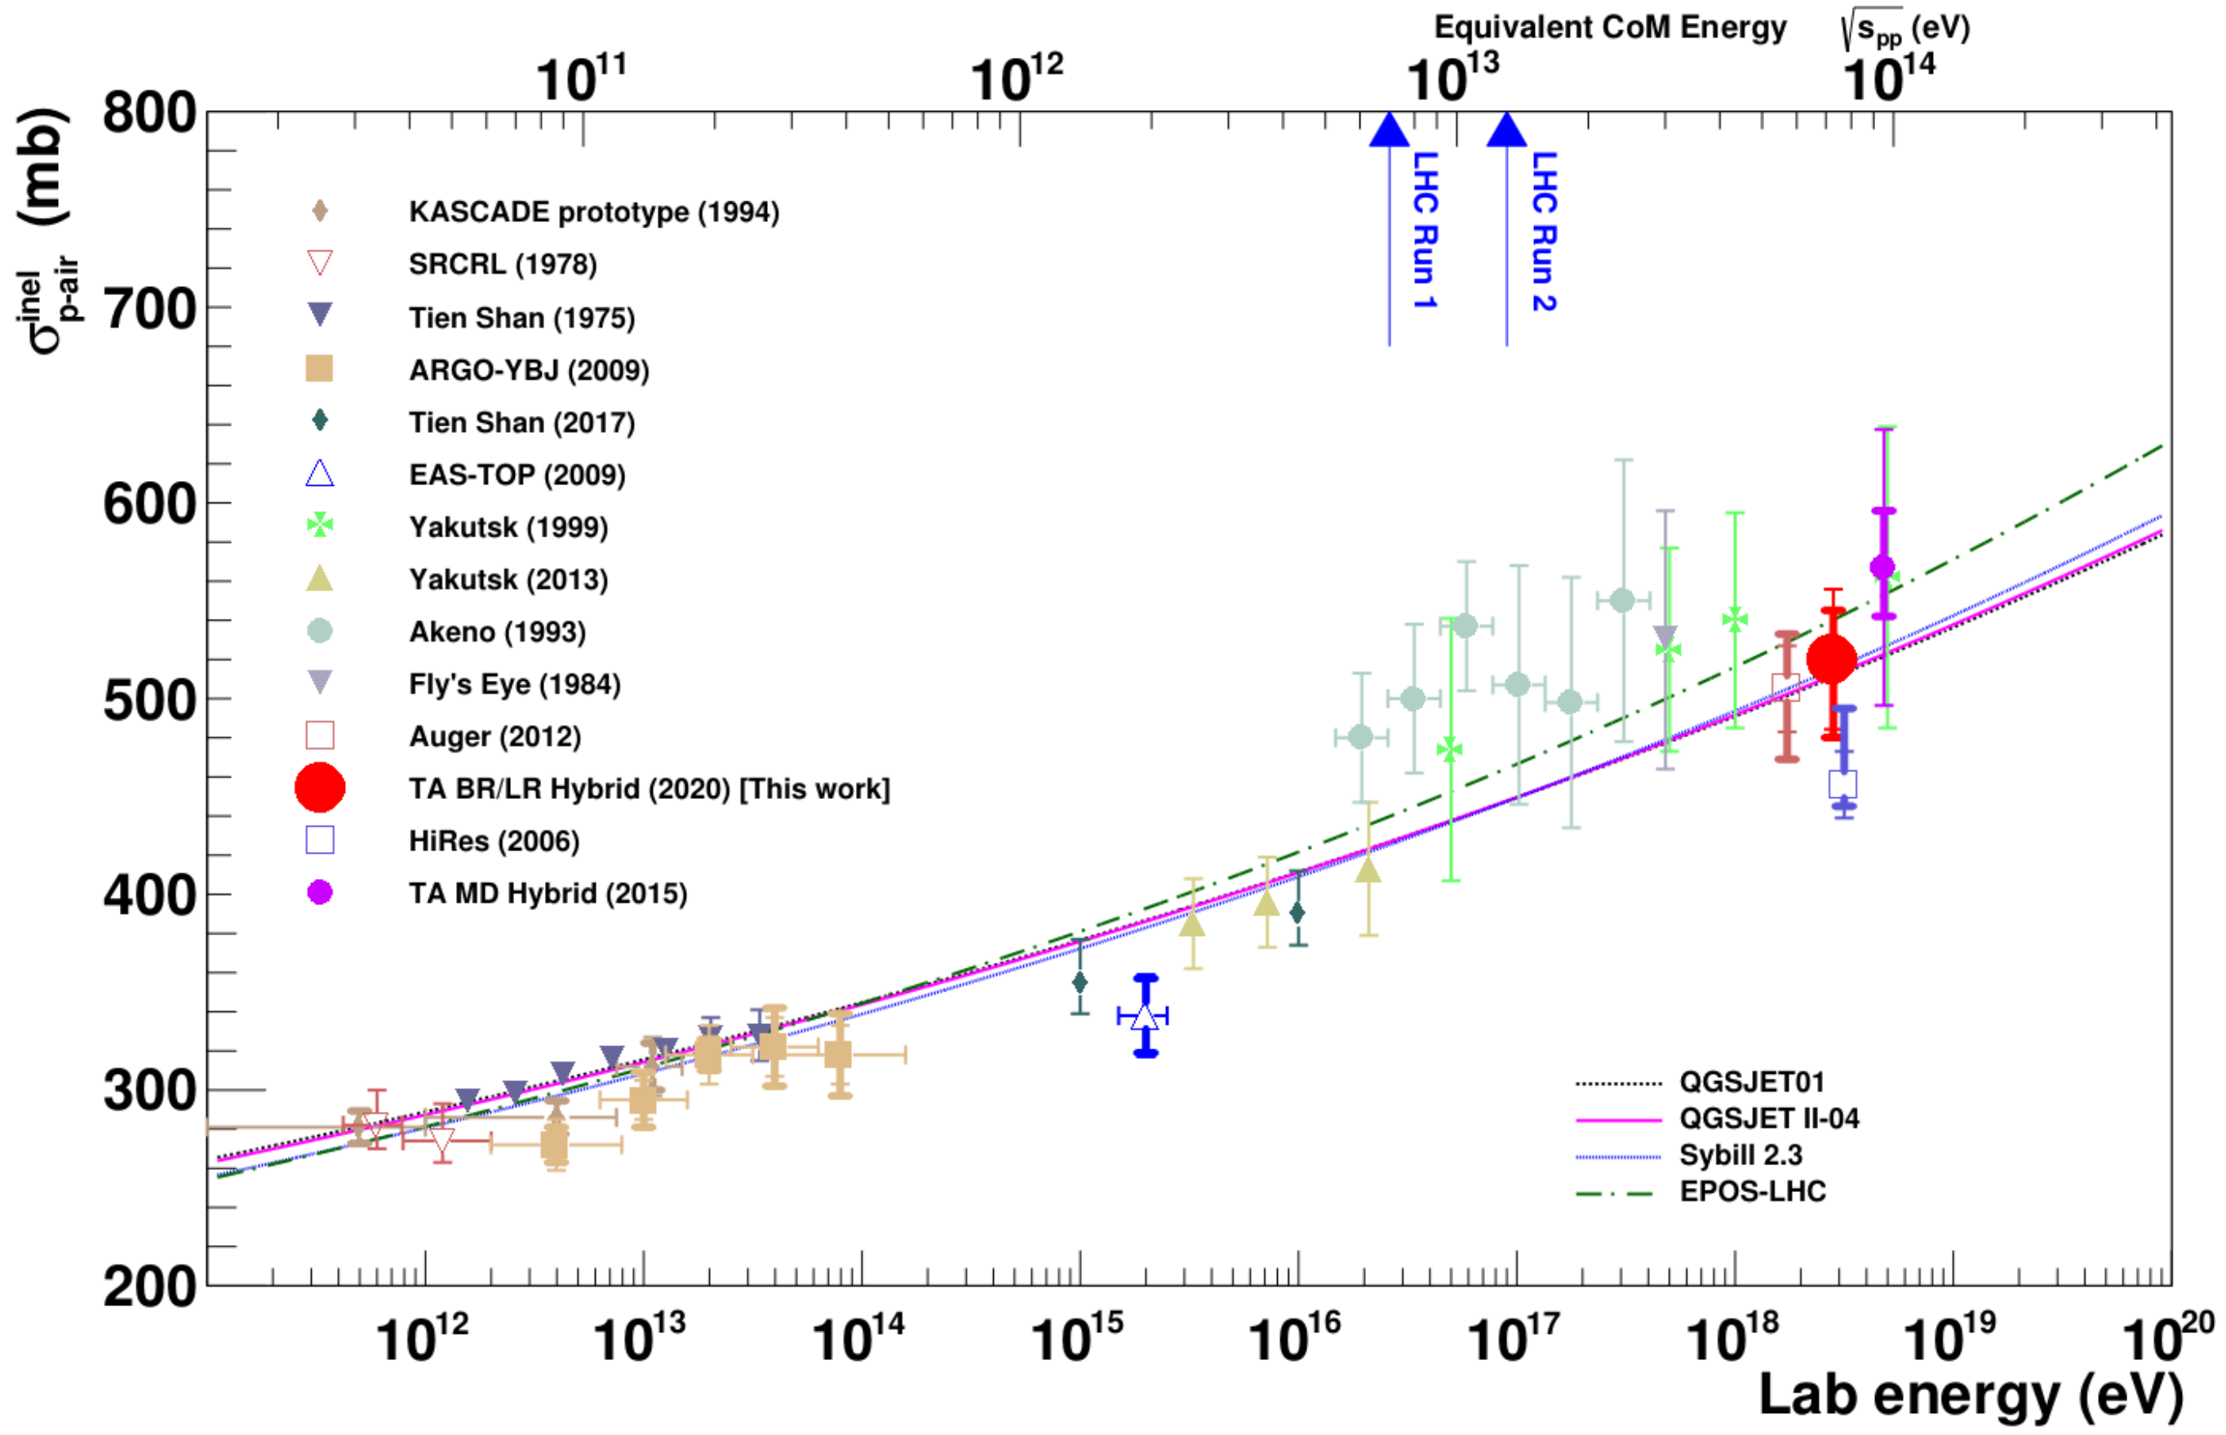
Muon Puzzle & Hadronic Uncertainties
”muon number”
Expected z
(“muon number”)
2012
2108.08341
1208.1520
Uncertainties at E > 10 PeV
2020
More muons measured than simulated for E > 40 PeV ~ cms 8 TeV
Precise pion/kaon ratio measurement needed
2006.05012

Slide 3

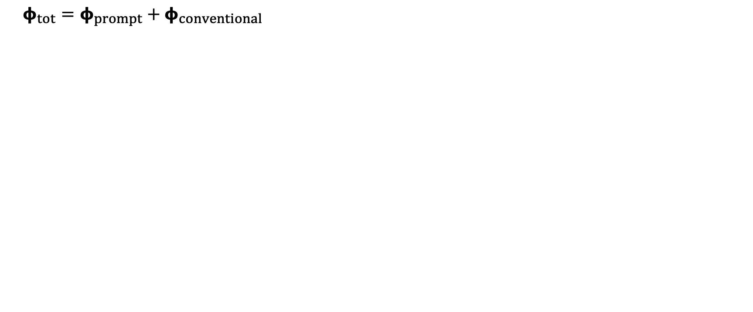
Muon Flux
Most energetic muon in bundle
Muon parent:
pion or kaon
yes
no
$φ_{tot}=φ_{prompt}+$ $φ_{conventional}$
conventional
prompt
Credit: Ludwig Neste
Notes:
gamma = 2.7: SNR → fermi/shock acceleration, propagation of cosmic rays lead to interactions with galactic magnetic fields, interactions with gas, energy losses (ionization and nuclear interactions), in this process, some cosmic rays can escape the magnetic fields → this rate is energy dependent → higher-energtic cosmic rays escape more quickly → steepening of spectrum to ~2.7

Slide 4
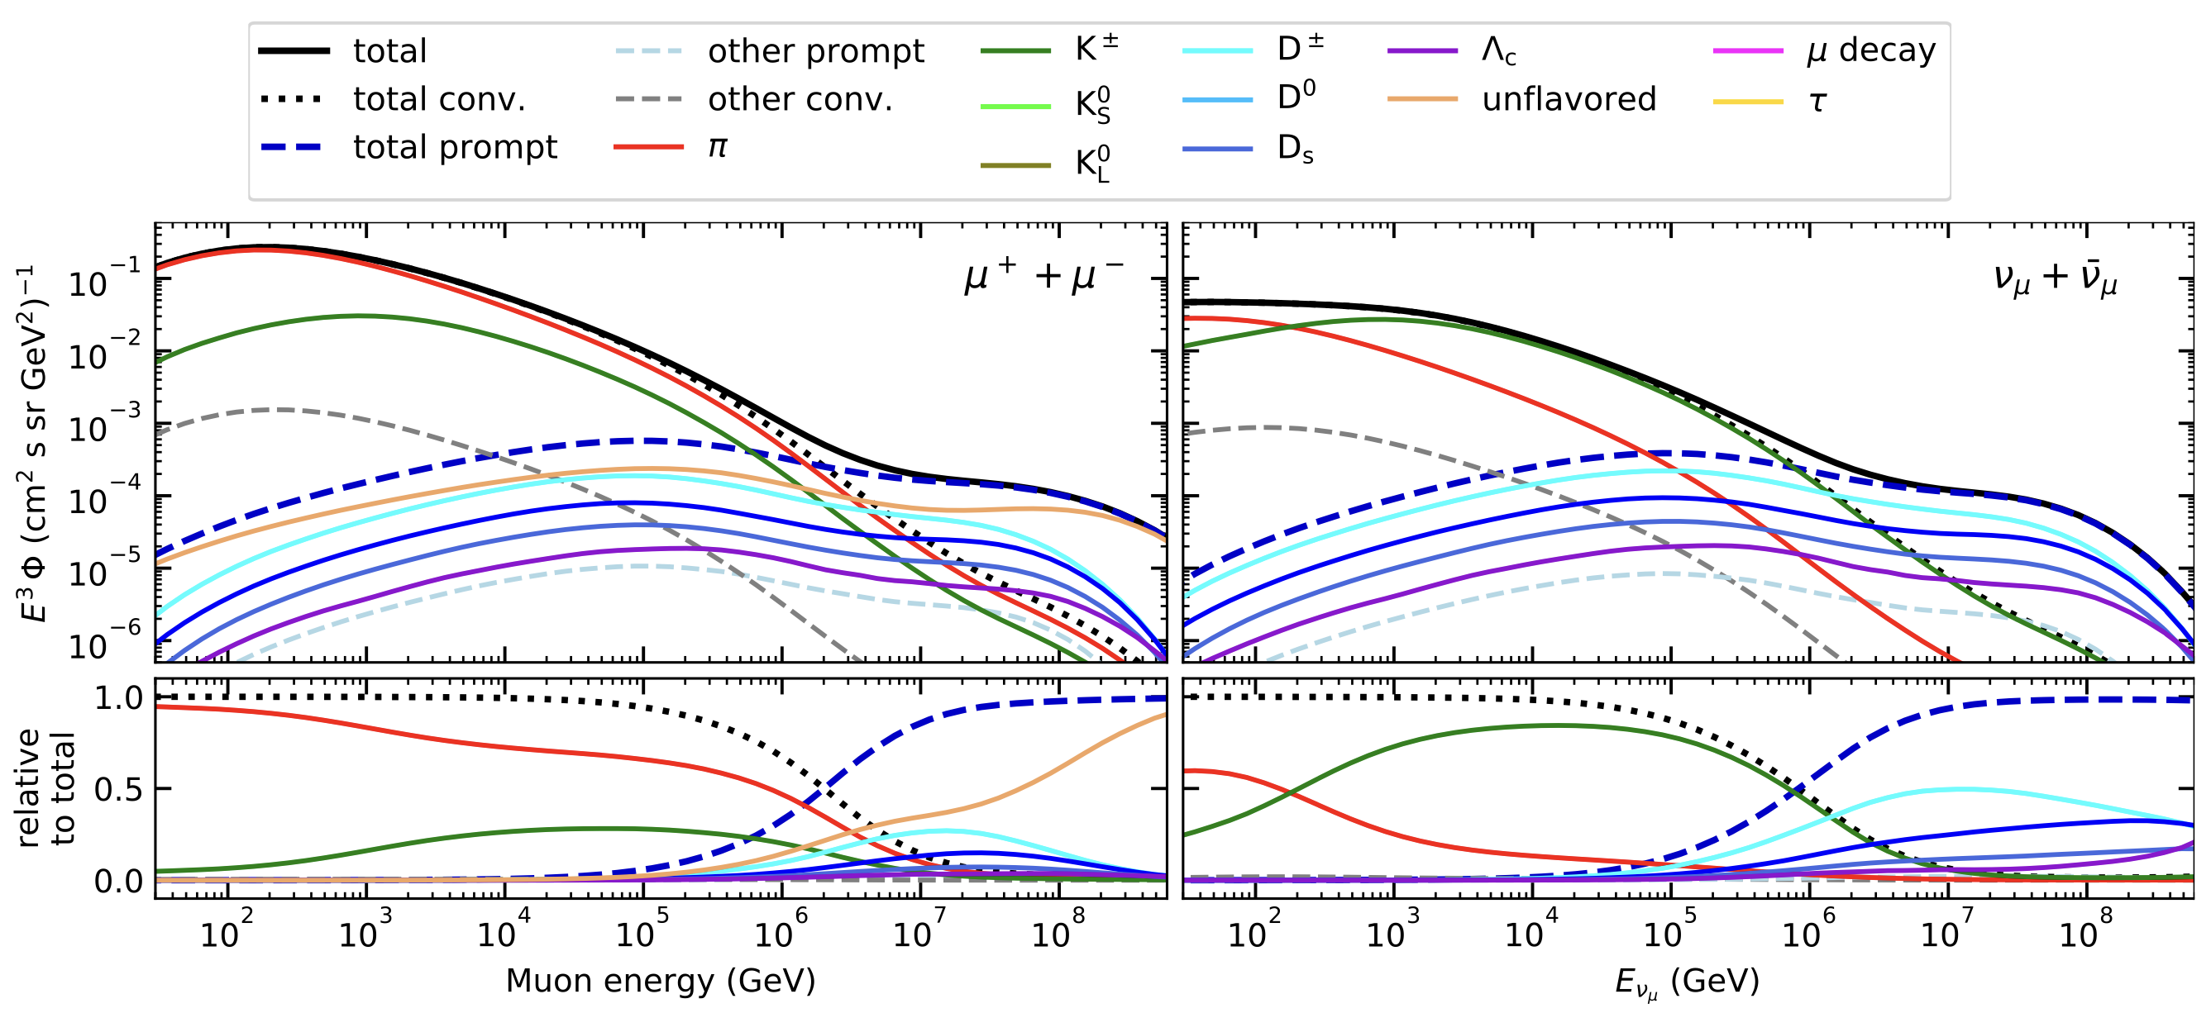
Prompt Atmospheric Muons & Neutrinos
10.1103/PhysRevD.100.103018
no unflavored
dominated by pions
dominated by kaons
Combined fit:
handle on pion/kaon ratio
handle on charmed mesons

Slide 5
Analysis Goals
Measure prompt component of the atmospheric muon flux
Unfold a muon energy spectrum
Idea:
New CORSIKA simulations with extended history
Tag muons by parent → prompt or conventional
Scale amount of prompt particles
Scaling saves time and resources instead of doing multiple simulations with different interaction models
Perform forward fit of the prompt normalization
Future:
Measure prompt neutrinos
Combined muon and neutrino fit → pion/kaon ratio

Slide 6
Overview
Analysis
Simulation
Reconstruction
Selection
Forward fit
Dataset
CORSIKA 77500 Ehist
SIBYLL 2.3d
10 TeV – 100 EeV
DNN reconstructions
Muon energies
Muon direction
Track geometry
Level 3
L2 muon filter
500 TeV bundle energy cut at surface
Add labels
Fit prompt normalization
Poisson LLH fit
Validation
Tag prompt / conv particles
MCEq comparisons
Unfolding
Level 4
Add DNN reconstructions
Muon spectrum
Unfold muon flux
Level 5
Data-MC quality cuts

Slide 7
Simulation

Slide 8
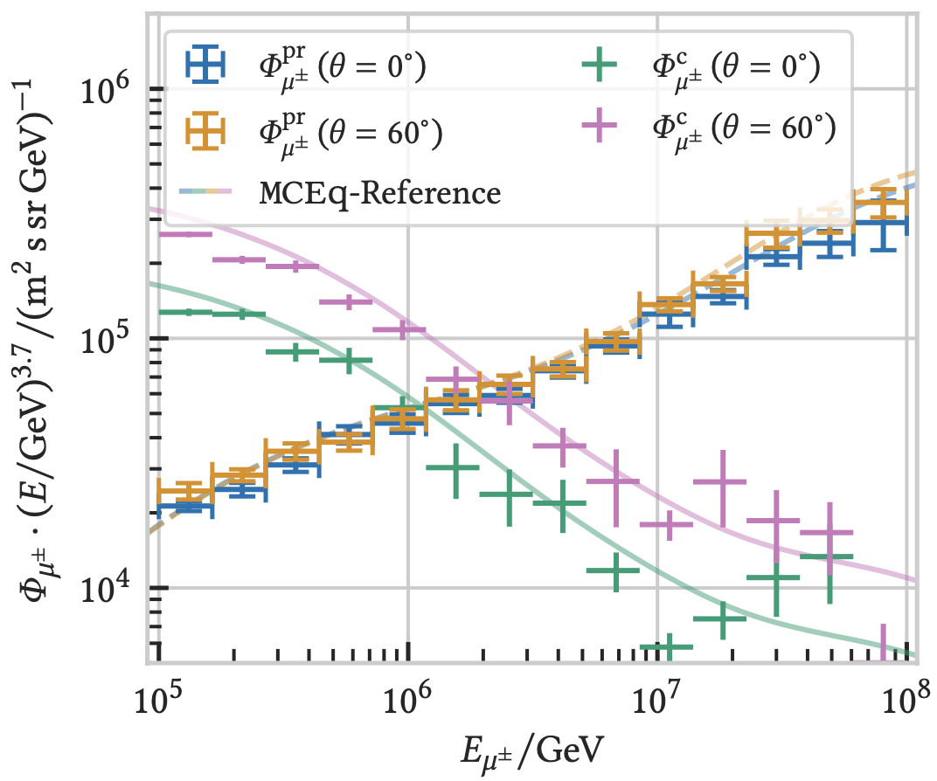

CORSIKA 7 vs. MCEq
MCEq: tool to numerically solve the cascade equations that describes the evolution of particle densities as they propagate through a gaseous, dense medium
https://github.com/mceq-project/MCEq
Good agreement for inclusive flux
Python package developed – PANAMA
Execute CORSIKA 7 (multi core)
Read DAT files → pandas DataFrames
Parse EHIST option
Calculate primary weightings
https://github.com/The-Ludwig/PANAMA
https://arxiv.org/pdf/2502.10951

Slide 9
Forward Fit

Slide 10
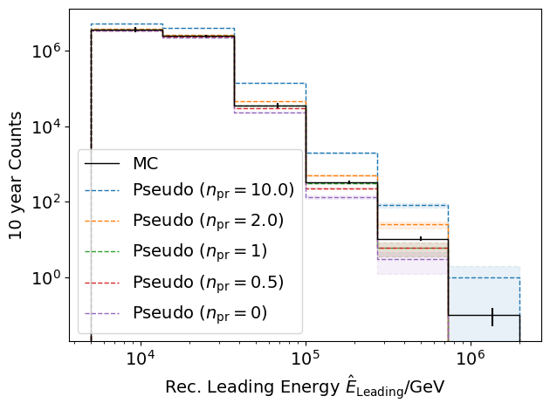
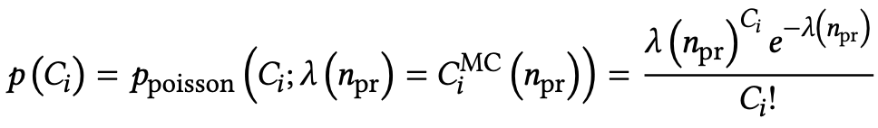
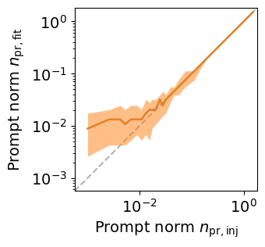
Poisson Likelihood Fit
Cuts:
L2 MuonFilter
Bundle energy at entry > 100 TeV
IceCube Preliminary
IceCube Preliminary
Tagging allows scaling of prompt by factor n_{pr}
Bias starts at a prompt normalization of 0.1

Slide 11
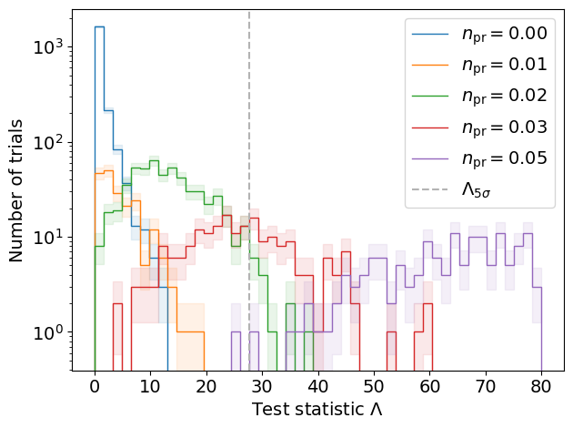
Discovery Potential and Sensitivity
Cuts:
L2 MuonFilter
Bundle energy at entry > 100 TeV
IceCube Preliminary
Expectation for 1 year:
5 sigma discovery potential: 0.102 ± 0.005
Sensitivity: 0.024 ± 0.001
Expectation for 10 years:
5 sigma discovery potential: 0.032 ± 0.001
Sensitivity: 0.007 ± 0.000
Caution:
Limited MC statistics -> events are oversampled in pseudo dataset
No systematics

Slide 12
Unfolding

Slide 13
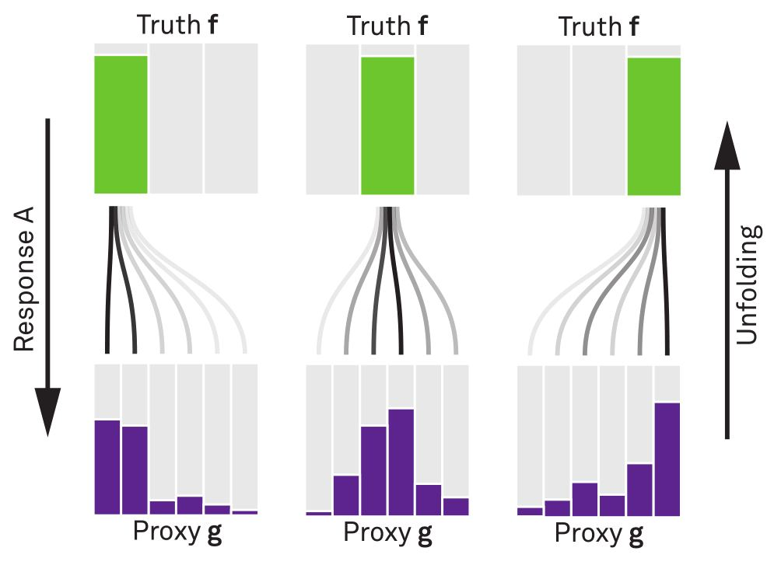


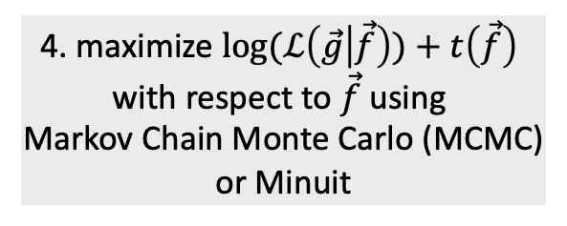
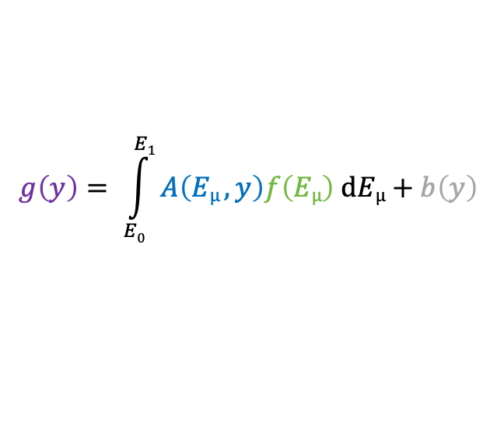
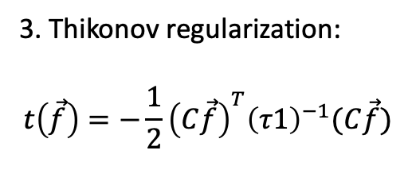
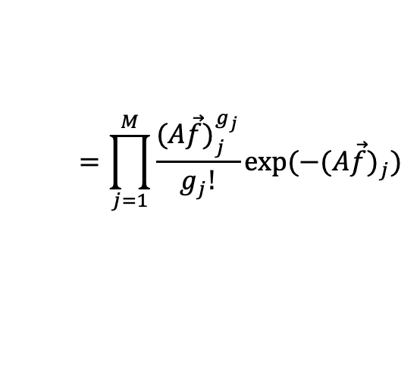
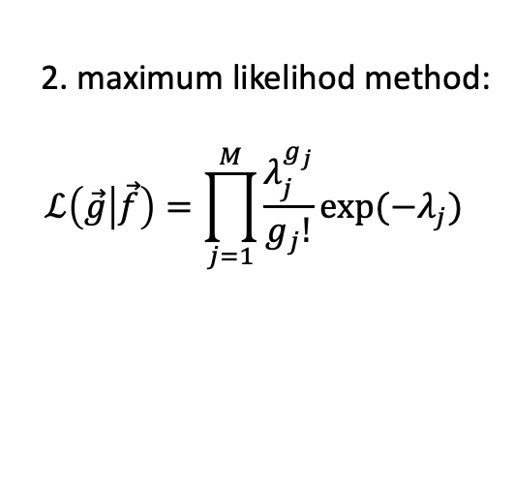
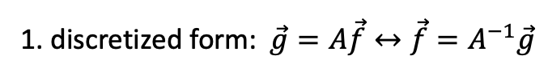
Unfolding in a Nutshell
folding
unfolding
measured proxy
detector response
background
1. discretized form: $\vec{g}=A\vec{f}↔\vec{f}=A^{−1}\vec{g}$
$$g\left(y\right)= \int_{E0}^{E1}{A\left(Eµ , y\right)f\left(Eµ\right) dEµ+b\left(y\right) }$$
2. maximum likelihod method:
$$ℒ\left(\vec{g} | \vec{f}\right)=\prod_{j=1}^{M}{\frac{λ_{j}^{g_{j}}}{g_{j}!}exp⁡(−λ_{j})}$$
3. Thikonov regularization:
$$t\left(\vec{f}\right)=−\frac{1}{2}{\left(C\vec{f}\right)}^{T}{\left(τ1\right)}^{−1}(C\vec{f})$$
true energy distribution
$$=\prod_{j=1}^{M}{\frac{{(A\vec{f})}_{j}^{g_{j}}}{g_{j}!}exp⁡(−{(A\vec{f})}_{j})}$$
funfolding
by M. Börner
4. maximize $log⁡(ℒ\left(\vec{g} | \vec{f}\right))+t\left(\vec{f}\right)$
with respect to $\vec{f}$ using
Markov Chain Monte Carlo (MCMC)
or Minuit
Credit: T. Hoinka

Slide 14
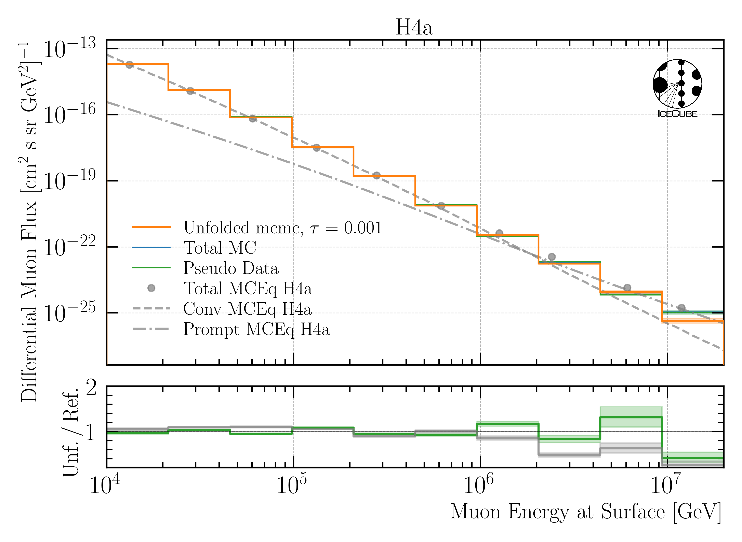
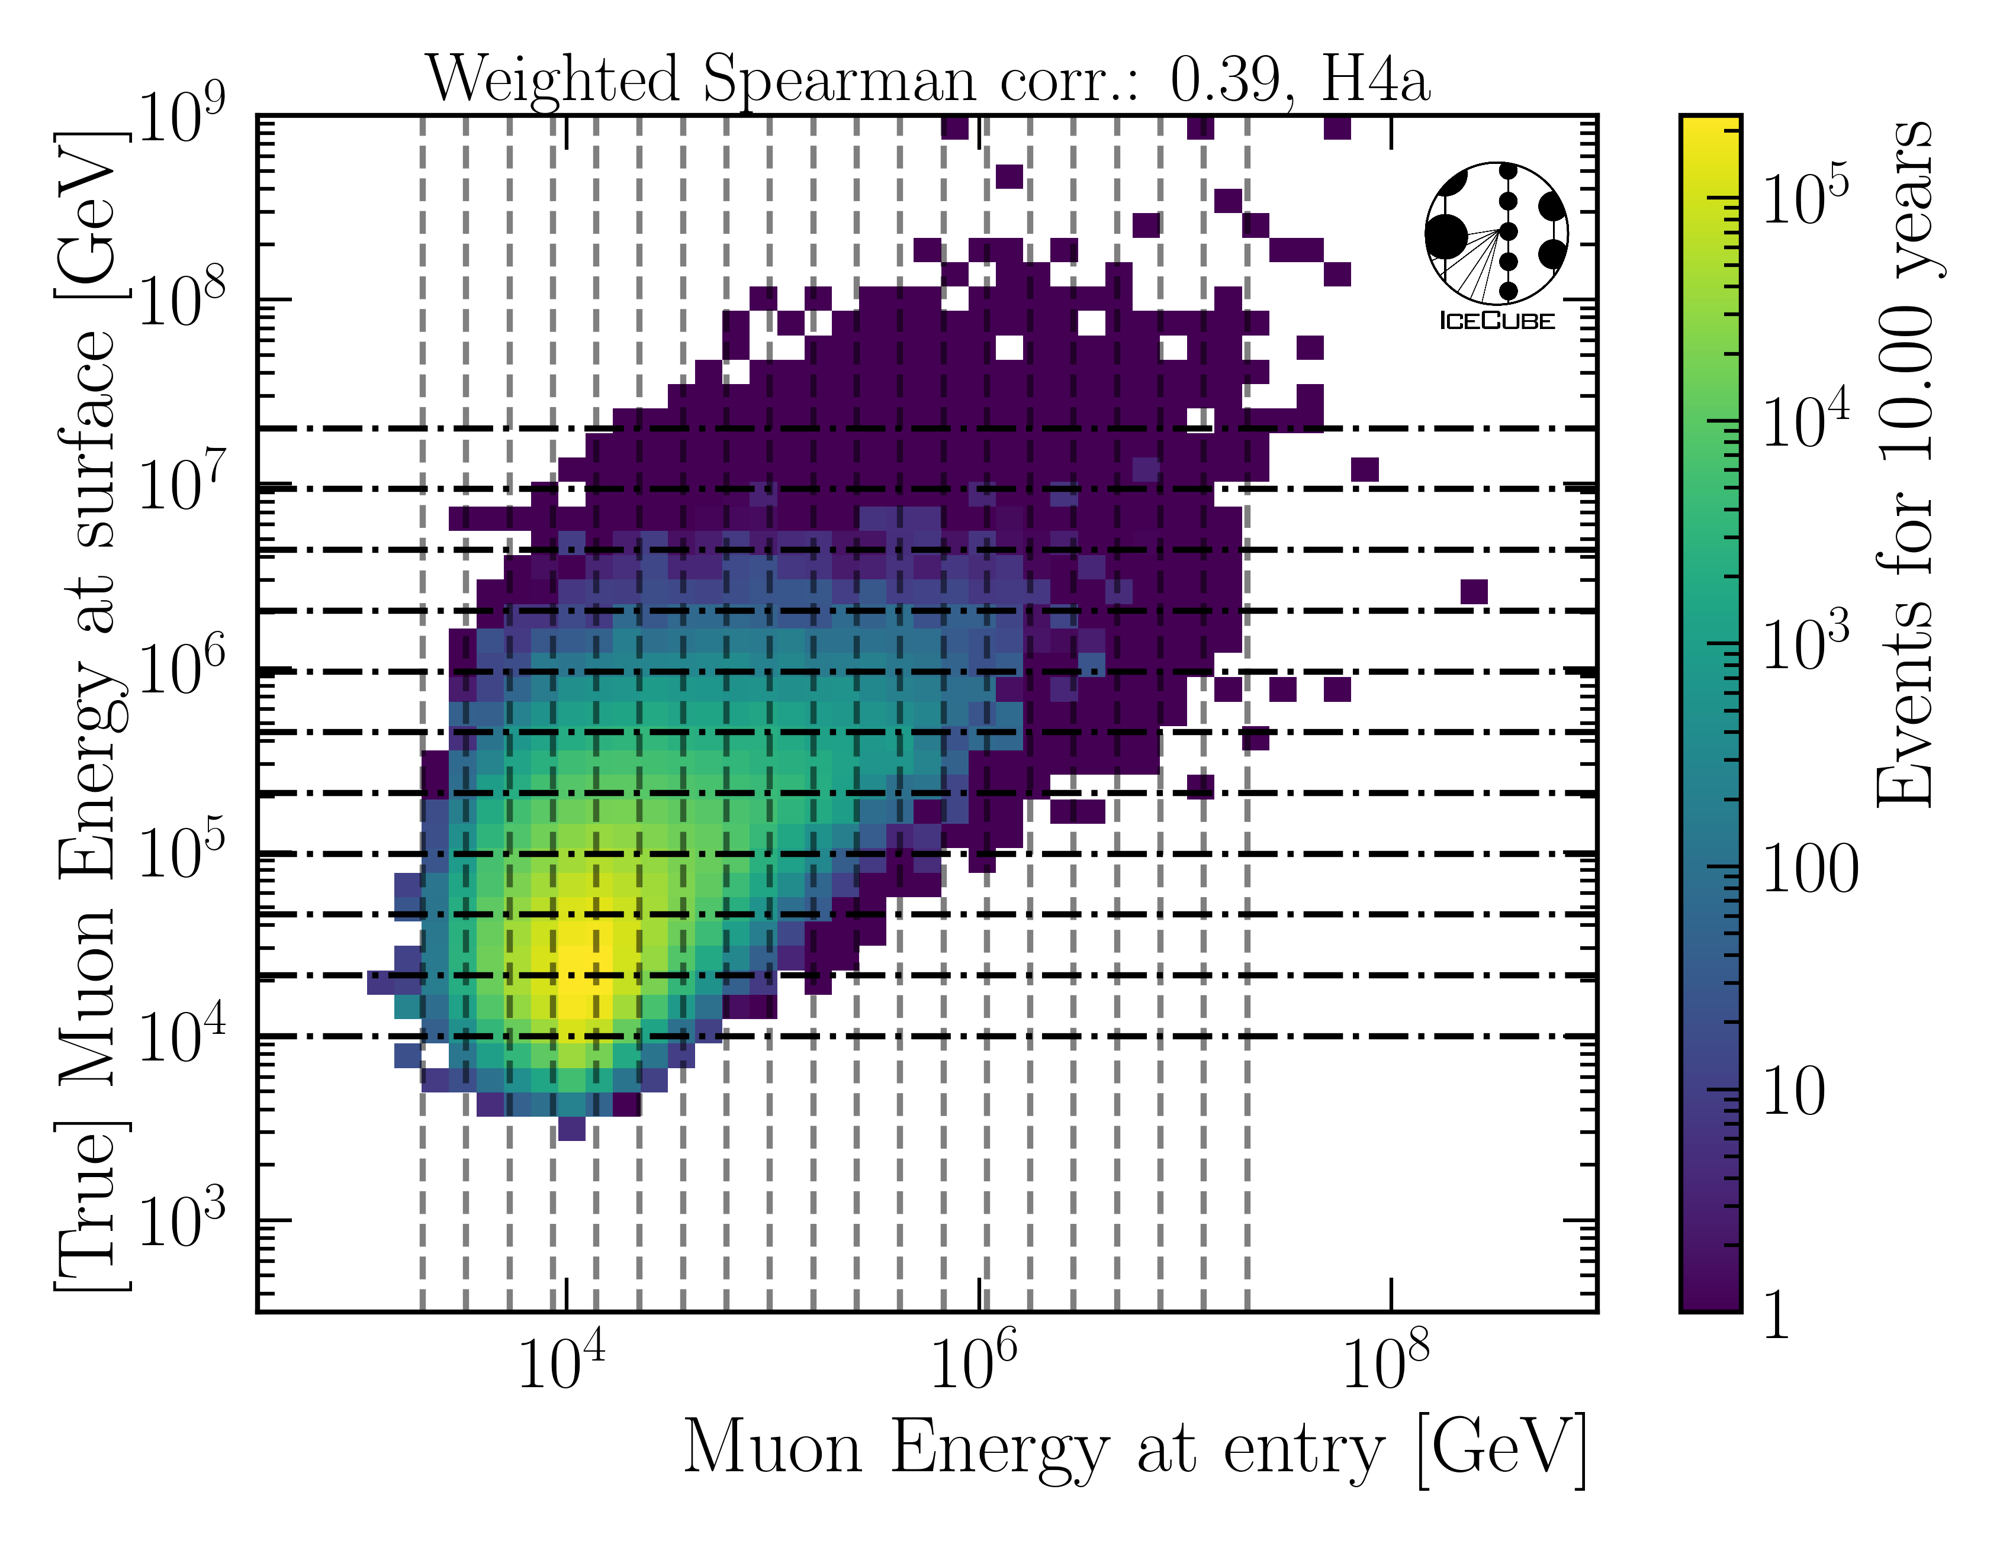
Unfolded Muon Flux at Surface
IceCube
Preliminary
IceCube Preliminary

Slide 15
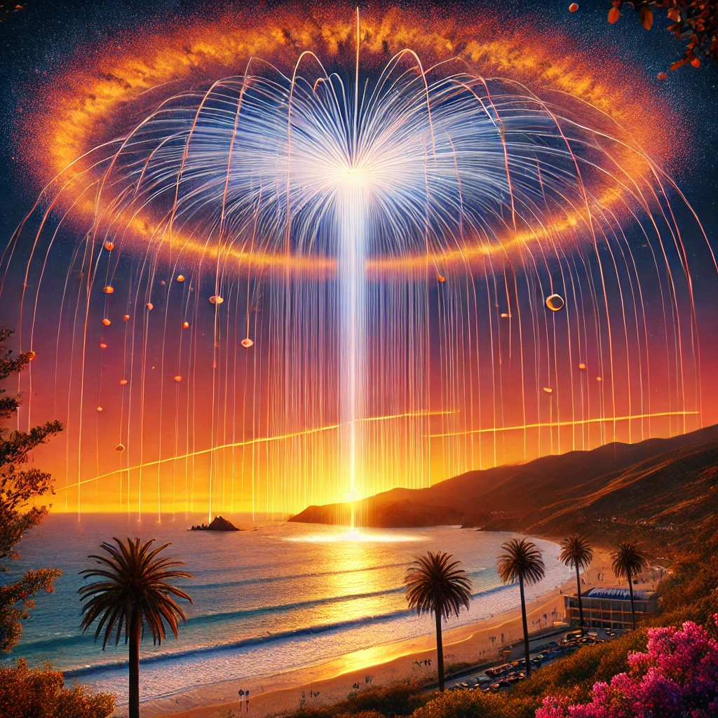
Conclusion & Outlook
New CORSIKA simulations with parent information
Tag prompt and conventional muons
Validation: agreement with MCEq
arXiv: 2502.10951
github.com/The-Ludwig/PANAMA
Fit of prompt normalization is promising
Include systematics
Unfolding of muon flux at surface works
Fine-tune regularization strength
How ChatGPT illustrates an air shower
at a California beach.
Thank you for your attention!

Slide 16
Backup

Slide 17
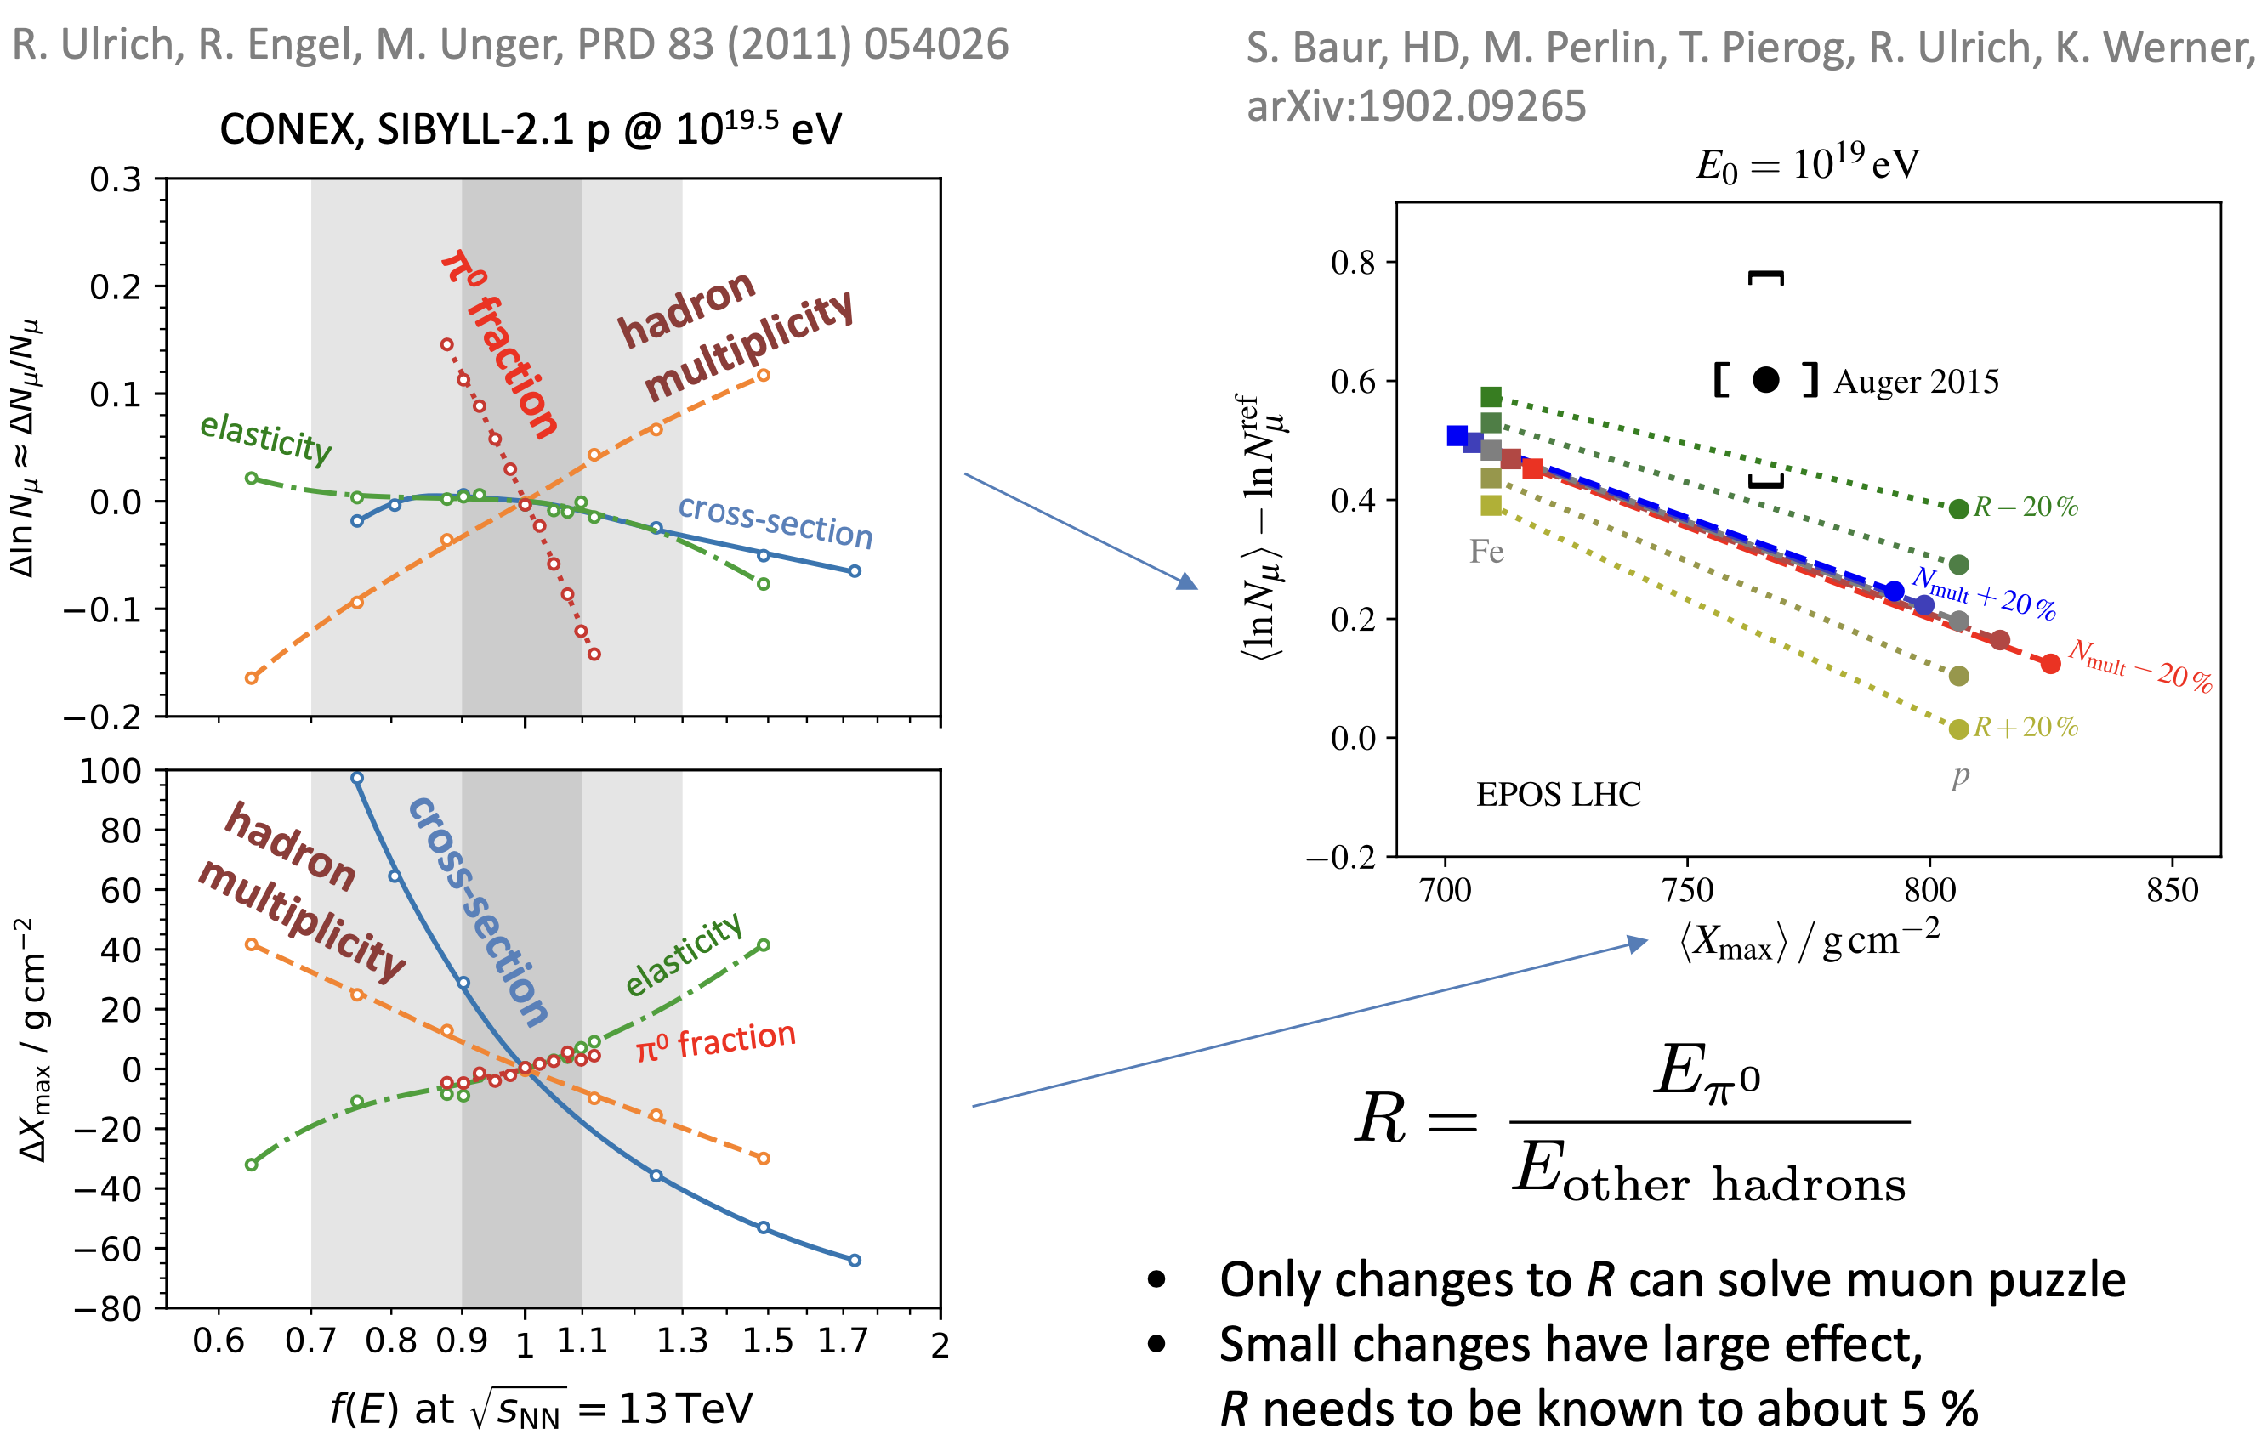
Possible Solutions
Hans Dembinski

Slide 18
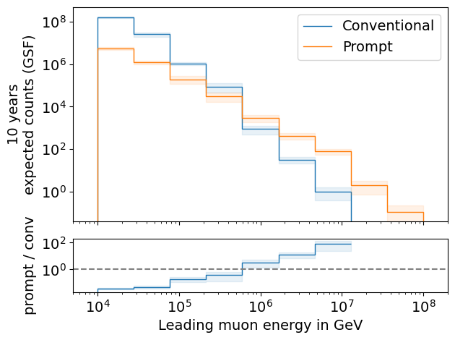
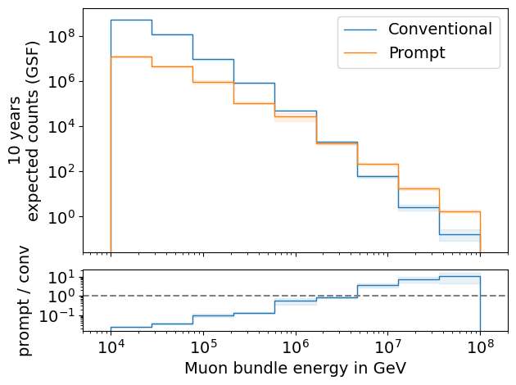
Expected Muons For 10 Years: Leading vs. Bundle Energy (GSF)
L2 MuonFilter
L2 MuonFilter
Both leading and bundle energy are sensitive to detect prompt
Leading muon energy is more sensitive

Slide 19
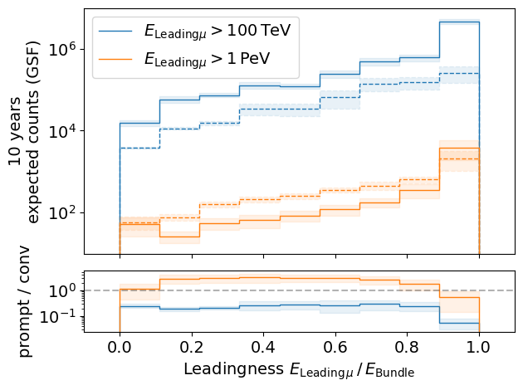
Leading Muon Energy Fraction
Solid: conventional
Dashed: prompt
Prompt dominates for energies > 1 PeV
Leading energy sweet spot: 0.1 – 0.9

Slide 20
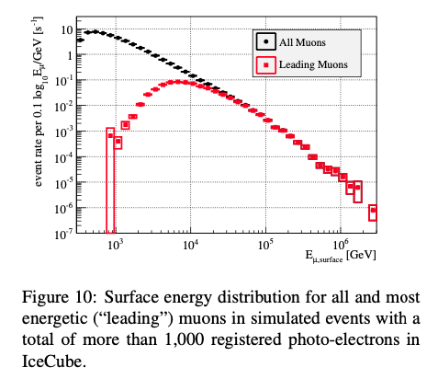
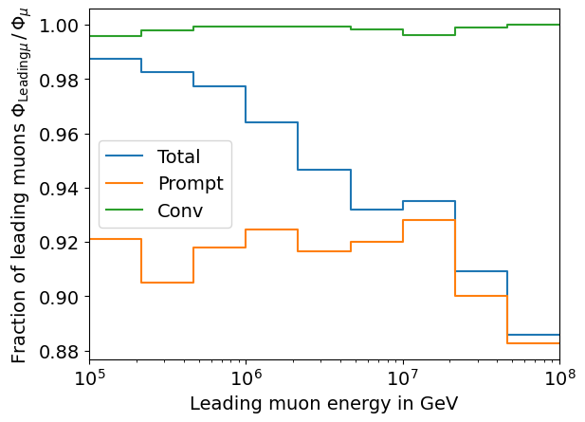
Leading Muon Contribution
Patrick Berghaus
Muons with energies between 100 TeV and 50 PeV dominate the bundle by more than 90%
In average conventional muons are more dominant than prompt
But: at high energies, there are more prompt than conventional events
High leading energy fraction does not lead to more sensitivity to detect prompt

Slide 21
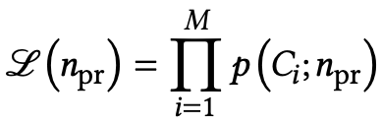
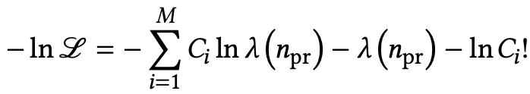
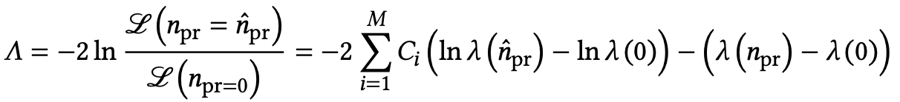
Poisson Likelihood Fit
Test bias
Cuts:
MuonFilter
Bundle energy > 100 TeV
Prompt scaling/normalization
MC counts per bin i
Conv norm = 1
Experimental counts
Maximize likelihood
With a constant conv norm:
bin counts depend only on prompt norm
= expectation value per bin
Easier:
minimize negative
log-likelihood
Test statistic for Wilks’ theorem
Bias starts at a prompt normalization of 0.1
Null hypothesis: no prompt

Slide 22
Tau = 0.001

Slide 23
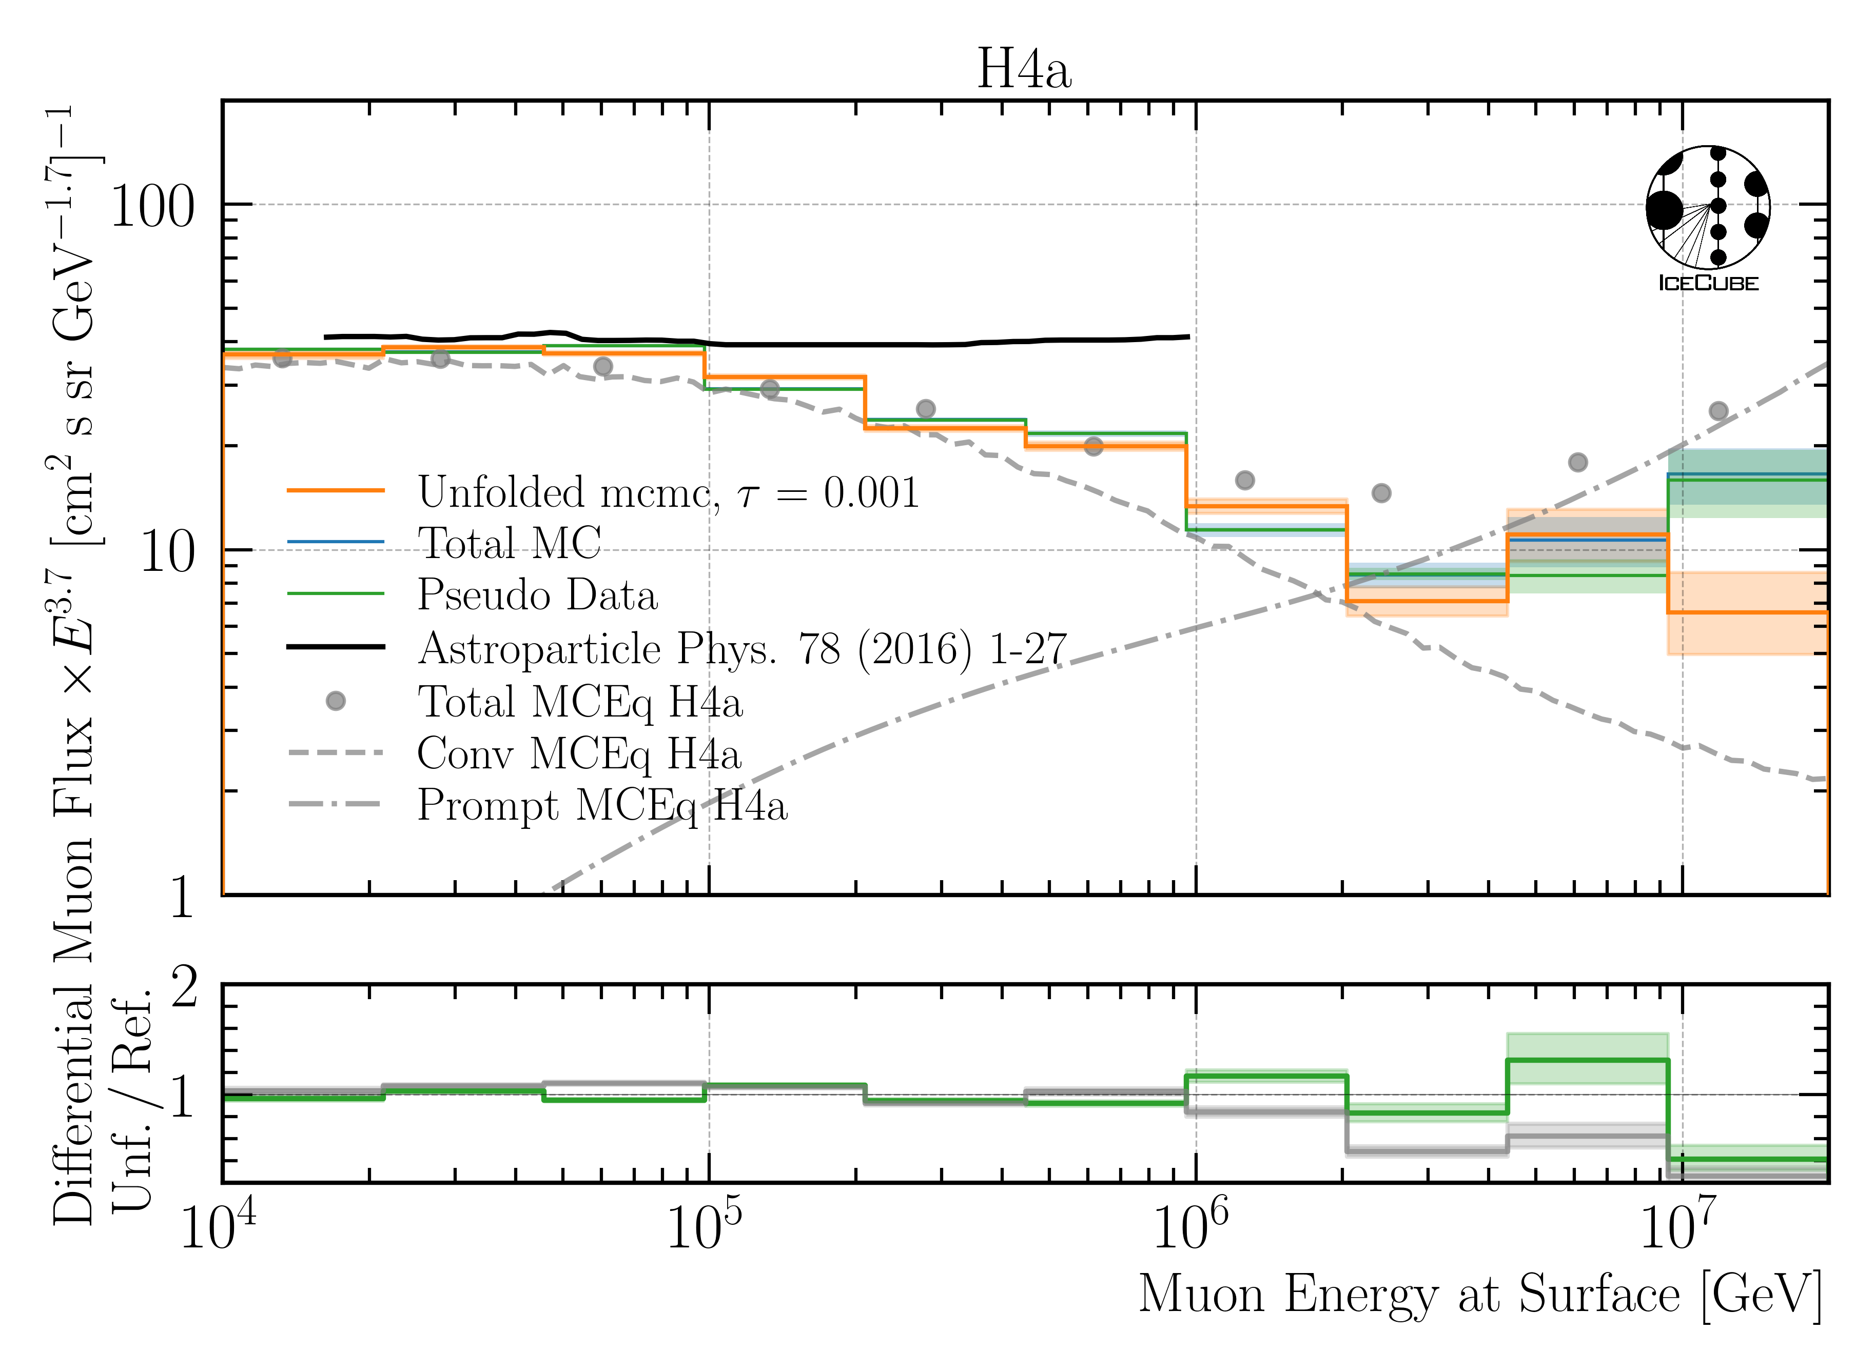
Unfolded Muon Flux at Surface

